Slide 1
Project 76 Group 04 Submitted by: Anusha Meesala Pushkar

Slide 2
Business Problem Need to perform Model Deployment

Slide 3
Overview of Machine Learning Lifecycle
Stage 1: Problem Definition
Stage 2: Data Collection
Stage 3: Data Exploration and Pre-processing
Stage 4: Model Building
Stage 5: Model Deployment

Slide 4
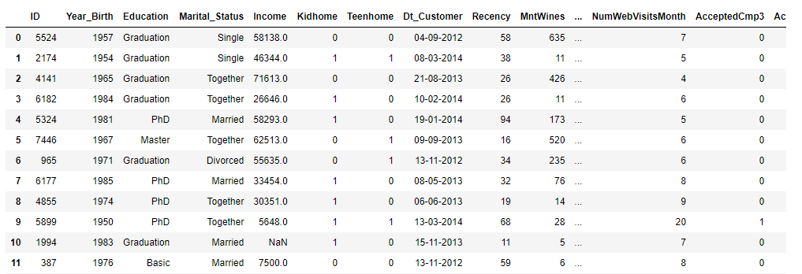
Import Data

Slide 5
Basic Transformations
Combine different types of purchase into one column
→ data['Purchases'] = data['NumDealsPurchases'] + data['NumWebPurchases'] + data['NumCatalogPurchases'] + data['NumStorePurchases']
Combine all types of amount spend into one column
→ data['Expenses'] = data['MntWines'] + data['MntFruits'] + data['MntMeatProducts'] + data['MntFishProducts'] + data['MntSweetProducts'] + data['MntGoldProds']
Combine all campaign into one column
→ data['Campaign'] = data['AcceptedCmp1'] + data['AcceptedCmp2'] + data['AcceptedCmp3'] + data['AcceptedCmp4'] + data['AcceptedCmp5']

Slide 6
Group Income data into 4 ranges (Below 25000, Income 25000-50000, Income 50000-100000, Above 100000)
→ data=data.assign(Incomes=pd.cut(data['Income'], bins=[ 0, 25000, 50000,100000,666666], labels=['Below 25000', 'Income 25000-50000 ', 'Income 50000-100000 ','Above 100000']))
Group Expense data into 4 ranges (0-500, 500-1000, Above 1000)
data=data.assign(Expense=pd.cut(data['Expenses'], bins=[ 0, 500, 1000, 2525], labels=['Below 500', 'Expense 500-1000 ','Above 1000']))
Group Birth Year data into 3 ranges (1959-1997, 1997-1977, Above 1997)
→ data=data.assign(DOB=pd.cut(data['Year_Birth'], bins=[ 0, 1959, 1977, 1996], labels=['Below 1959', 'DOB 1959-1977', 'DOB 1977-1996']))

Slide 7
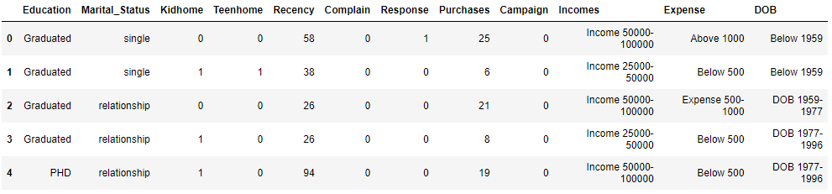
Group different marital status into two category
→ data['Marital_Status'] = data['Marital_Status'].replace(['Married', 'Together'], 'relationship')
→ data['Marital_Status'] = data['Marital_Status'].replace(['Single', 'Divorced', 'Widow', 'Alone', 'Absurd', 'YOLO'], 'single')
Group different education status into three category
→ data['Eduation'] = data['Education'].replace(['2n Cycle', 'Basic'], 'Basic')
→ data['Education'] = data['Education'].replace(['Graduation', 'Master'], 'Graduated')
→ data['Education'] = data['Education'].replace(['PhD'], 'PHD')

Slide 8
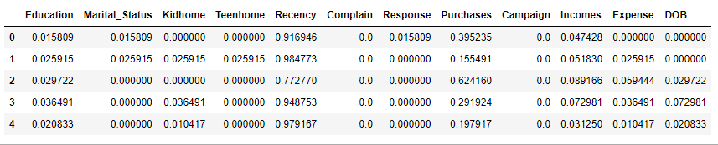
Data Pre- Processing
Label encoding to convert data into numeric
→ data['Education']= label_encoder.fit_transform(data['Education'])
→ data['Marital_Status']= label_encoder.fit_transform(data['Marital_Status'])
→ data['Incomes']= label_encoder.fit_transform(data['Incomes'])
→ data['DOB']= label_encoder.fit_transform(data['DOB'])
→ data['Expense']= label_encoder.fit_transform(data['Expense'])
Data normalize

Slide 9
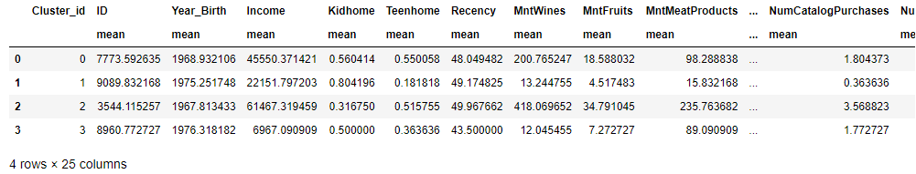
Clustering & Model Building
→ hc=AgglomerativeClustering(n_clusters=4,affinity='euclidean',linkage="ward")
Group data by Cluster ID :
→ df.groupby("Cluster_id").agg(['mean']).reset_index()

Slide 10
Split data into X and Y variable
→ X = data.drop("Cluster_id", axis=1)
→ y = data.Cluster_id
→ X.shape, y.shape
→ from sklearn.model_selection import train_test_split
→ x_train, x_cv, y_train, y_cv = train_test_split(X,y, test_size = 0.2, random_state = 10)
Import Classifier
→ from sklearn.ensemble import RandomForestClassifier
→ model = RandomForestClassifier(max_depth=4, random_state = 10)
→ model.fit(x_train, y_train)
Saving the model
→ import pickle
→ pickle_out = open("classifier.pkl", mode = "wb")
→ pickle.dump(model, pickle_out)
→ pickle_out.close()

Slide 11
Model Deployment Using Streamlit
Model Building
Creating a python script
Create front-end: Python
→ Deploy

Slide 12
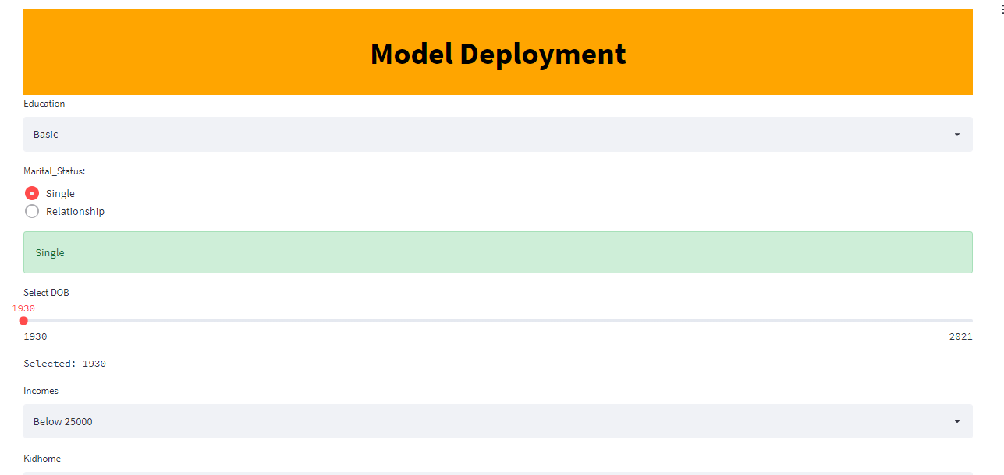
Output:

